Slide 1
Computer Graphics
creation and manipulation of visual images using computers

Slide 2
Introduction to Computer Graphics
The creation, manipulation, and display of visual content on digital platforms.
Utilized across various industries to represent data visually, including science, engineering, medicine, entertainment, advertising, and education.

Slide 3
Applications of Computer Graphics
Design & Visualization:
CAD for architecture, product design, engineering.
Simulation and dynamic visualization enhance creativity.
Entertainment:
CGI in film and animation.
Realistic graphics in video games.
Medical & Scientific Visualization:
Diagnostic imaging and 3D modeling.
E-Learning:
Interactive and engaging educational content.

Slide 4
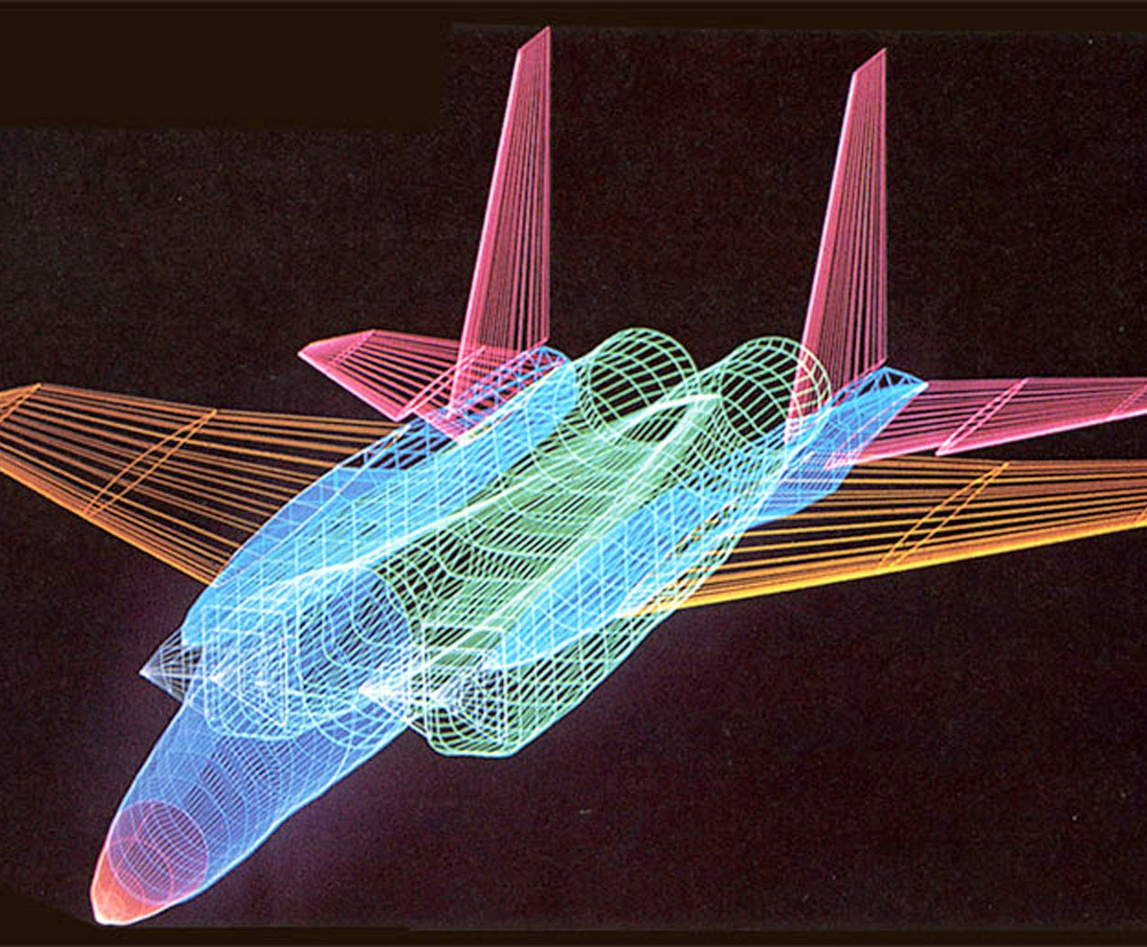
Pixels & Resolution
Pixel:
The smallest unit of a digital image displayed on a screen.
Resolution:
Image Resolution: Pixel density (PPI).
Screen Resolution: Total number of pixels in both dimensions.

Slide 5
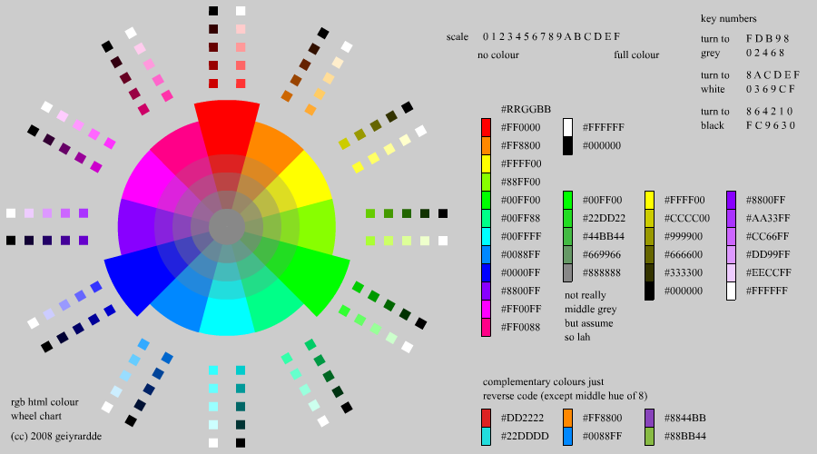
Color Depth & Bitplanes
Color Depth: The number of colors a pixel can
represent.
True Color: 24-bit (16.7 million colors).
High Color: 16-bit (65,536 colors).
256-Color Mode: 8-bit (256 colors).
Bitplanes:
Memory used to store pixel color intensity.
More bitplanes = better color detail.

Slide 6
Frame Buffer & Video Memory
Frame Buffer: Holds the current image on the screen.
Video Memory Calculation:
Memory (MB) = (X-resolution * Y-resolution * Bits per pixel) / (8 * 1024 * 1024)

Slide 7
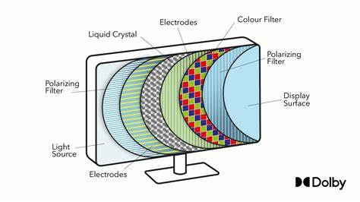
Display Technologies
Raster Scan Display: Pixels are drawn left-to-right, top-to-bottom.
Random Scan Display: Directly targets specific points, used for sharper vector images.

Slide 8
Flat Panel Displays
LCD (Liquid Crystal Display): Thin, energy-efficient, and high resolution.
Plasma Display: Uses ionized gas to create vivid colors, great for large screens but expensive.
3D Displays
Stereoscopic & VR: Creates 3D visuals for immersive experiences in virtual reality and simulations.

Slide 9
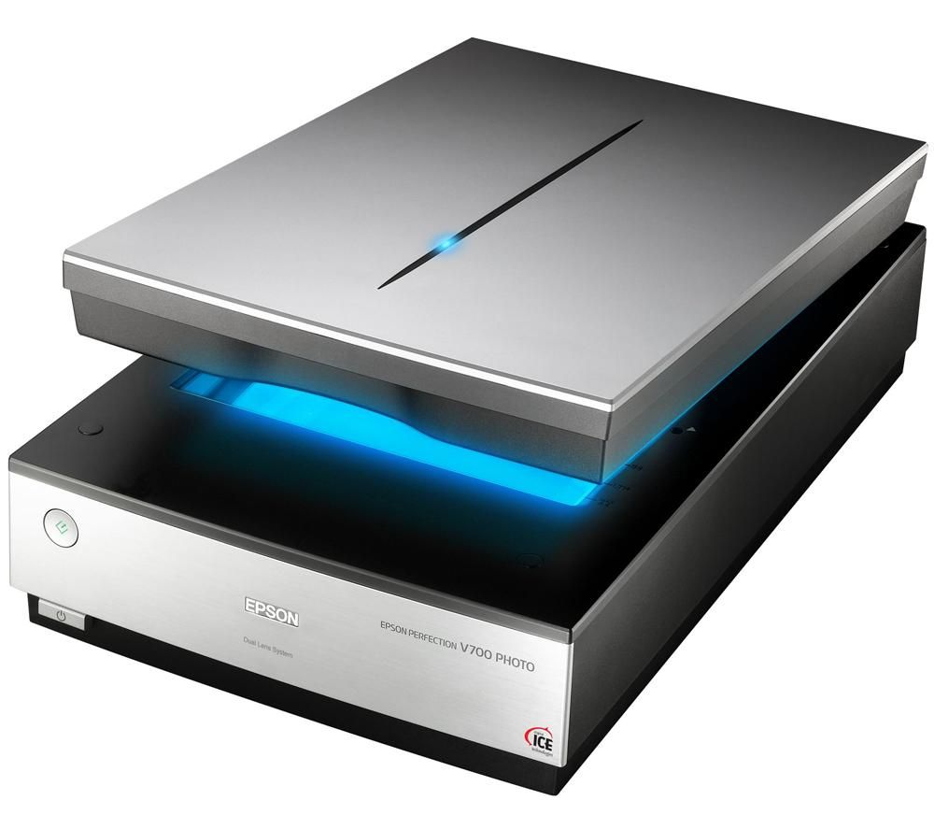
Image Scanners
Drum Scanner: High-end, professional quality scanning.
Flatbed Scanner: Versatile, general-purpose scanner.
Handheld Scanner: Portable, used for quick document scanning.

Slide 10
Summary
Empowers Creativity: Used in design, entertainment, and interactive media.
Improves Efficiency: Essential in industries like healthcare, science, and education.
Future Innovation: Driving AR/VR advancements and shaping interactive technologies.

Slide 11

Thank You!

